Slide 1


YOUTUBE SONGS ANALYSIS ON POWER BI
JULIANA UDEGBULEM

Slide 2
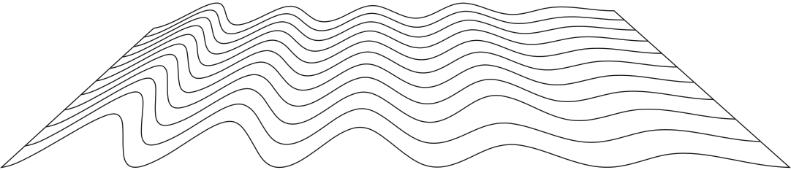
Overview
Problem Statement
Temporal Trends
Dataset Description
User Engagement Insights
Data cleaning and prepartion
Findings
Exploratory Data Analysis
Recommendation
Content and Channel Analysis

Slide 3

PROBLEM STATEMENT
◦This project aims to conduct a comprehensive analysis of Youtube songs data using Power BI.
◦ The dataset contains key attributes such as video ID, channel title, title, description, tags, published date, view count, like count, favorite count, comment count, video duration, video definition and caption details.
◦ The goal is to utilize Power BI to create insightful visualization and report that provide a deeper understanding of Youtube songs perfomance, popularity and user engagement.
◦ The analysis aims to uncover trends, preferences, and patterns in the data to aid content creators and stakeholders in optimizing their Youtube song content.

Slide 4
Dataset Description
1. video_id: Unique identifier for each YouTube video.
2. channelTitle: Title of the YouTube channel publishing the song.
3. title: Title of the YouTube song video.
4. description: Description provided for the YouTube song video.
5. tags: Tags associated with the YouTube song video.
6. publishedAt: Date and time when the YouTube song video was published.
7. viewCount: Number of views received by the YouTube song video.
8. likeCount: Number of likes received by the YouTube song video.
9. favoriteCount: Number of times the YouTube song video has been marked as a favorite.
10. commentCount: Number of comments posted on the YouTube song video.
11. duration: Duration of the YouTube song video.
12. definition: Video definition or quality (e.g., HD, SD).
13. caption: Availability of captions for the YouTube song video.

Slide 5

DATA CLEANING AND PREPARATION
◦ The dataset was imported into Power BI in an Excel format and loaded.
◦ The dataset does not have any duplicates.
◦ The data was cleaned using Power Query, first column was deleted as it was not necessary for the analysis.
◦ The Likecount, Commentcount, and Viewcount were formatted with a comma.
◦ The datasets are all in their right formats (texts and numbers).
◦ The duration column was changed to 4 decimal points using the and the Publishat was changed to short date format.
◦ Missing values was deleted.

Slide 6

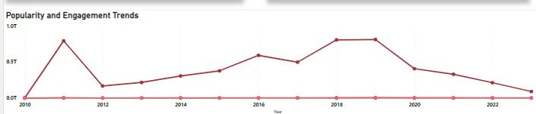
Exploratory Data Analysis (EDA)
• Patterns and distributions in the dataset was explored. New measures were created for Popularity, Total Songs, Average Like Counts, and Average Comment Counts
To identify trends in the Popularity and Engagement of Youtube songs a Line Chart was used to compare the values of Likecount, Viewcount and Commentcount

Slide 7
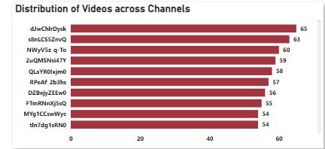
CONTENT AND CHANNEL ANALYSIS
To analyze the distribution of videos across different channels, a Stacked bar chart was used

Slide 8

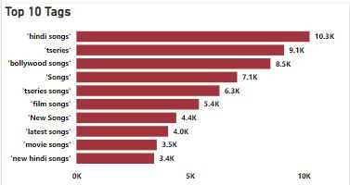
To Identify popular tags I used a clustered bar chart to visualize top 10 tags and their correlation with view counts.

Slide 9
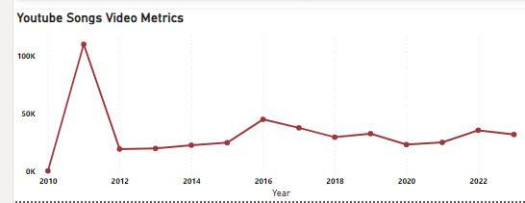
TEMPORAL TRENDS
To explore how YouTube song video metrics vary over time, I used a line chart to compare the years in the dataset.

Slide 10
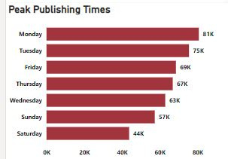
To identify peak publishing times and their impact on engagement

Slide 11
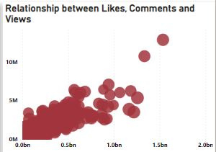
USER ENGAGEMENT INSIGHTS
To investigate the relationship between Likes, Comments and Views I used a scatter plot, larger bubbles indicates videos with more comments

Slide 12
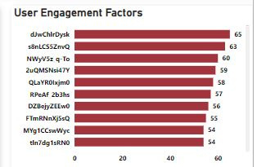
To identify factors affecting user engagement with Youtube songs videos, I used a clustered bar chart to visualize metrics

Slide 13
Based on my analysis, videos posted on Mondays recieve the highest average number of views compared to the other days of the week.
The data shows that 2011 was the peak year for views, indicatng that the content posted in that year recieved the highest engagement.
INSIGHTS
There is a strong positive correltion between view count, like count and comment count, meaning that as the number of views increases, the number of likes and comment tends to increase as well and videos with more views tends to get more likes and comments.
JULIANA UDEGBULEM

Slide 14

To maximize engagement and viewership, schedule the release of new Youtube song videos to Monday.
While it is not possible to change the past, understanding that 2011 was a peak year for views can help us analyze the content strategies used during that time to replicate successful elements in present and future videos.
RECOMMENDATION
Focus on creating high-quality, engaging content that attracts the viewers, as this will also likely increase the number of likes. Encouraging viewers to like the video can further boost engagement.

Slide 15
THANK YOU
JULIANA UDEGBULEM

